Slide 1
Dashboard & Widget
Company
Widget
Common
Widget
Factory
Widget
Equipment
Widget
Company Board
Factory Board
Equipment Board

Slide 2
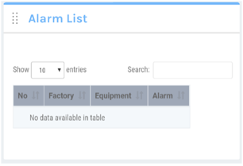
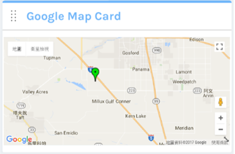
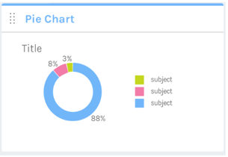
Dashboard & Widget Flow
Restful API
SignalR Hub
var _compnayId = 5;
var _boardLevel = ‘company’;
1. Request board setting by ID
3.1 Retrieve historical data
3.2 Retrieve metadata
WebApp
3.3 Connect to SignalR
2. Generate Board Web Page and Widgets
3.4 Receive push message from SignalR
Any Board

Slide 3
Common Widget
No | Widget
1 | Company Logo
2 | Company Location
3 | Alarm
4 | Alarm History
5 | Line Chart
6 | Bar Chart
7 | Percentage Chart
8 | Pie Chart
9 | One Text
10 | Test List
11 | Simple OEE
12 | Preferred OEE
No | Widget
13 | HTML Content
14 | Location Trace
15 | CCTV

Slide 4
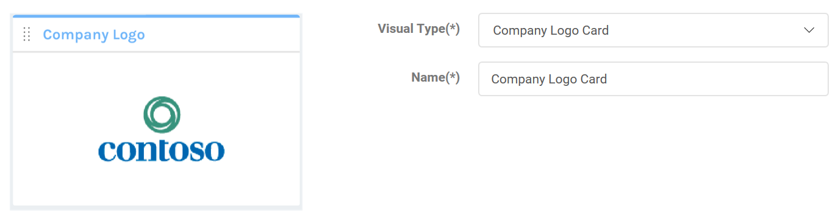

Company Logo

Slide 5
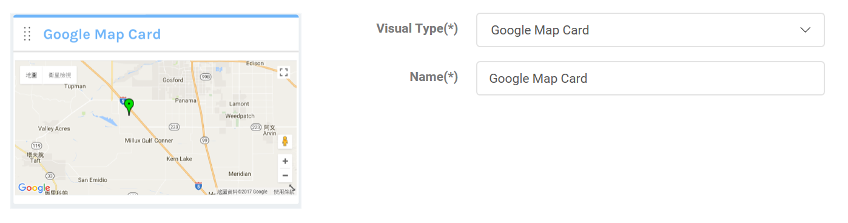
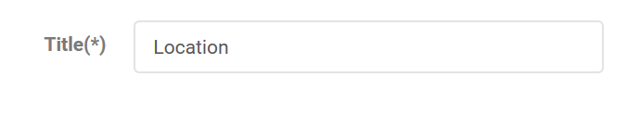
Company Location
+ Initial Zoom Level

Slide 6
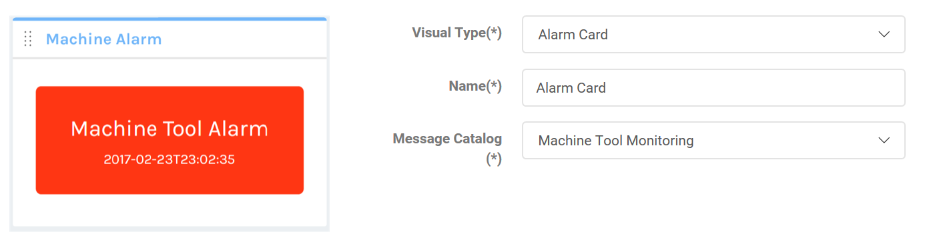
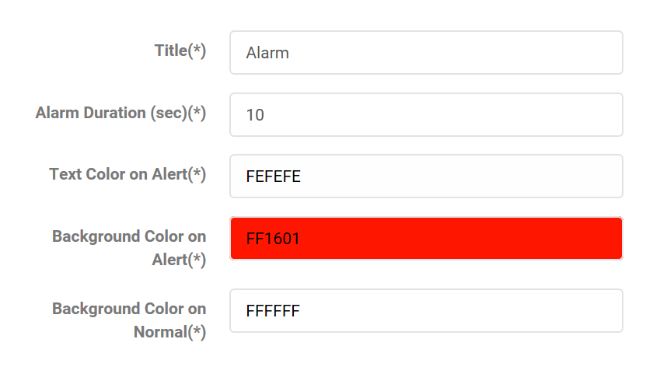
Alarm

Slide 7
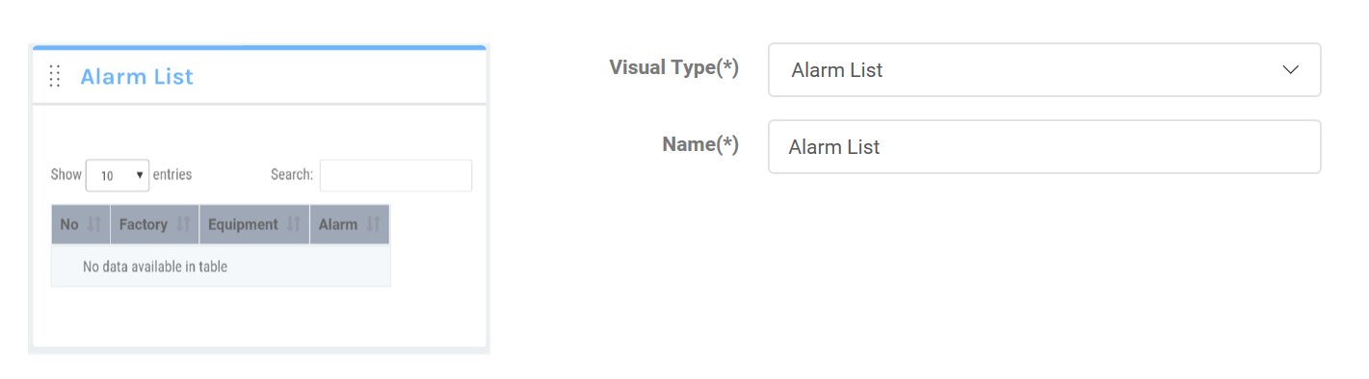
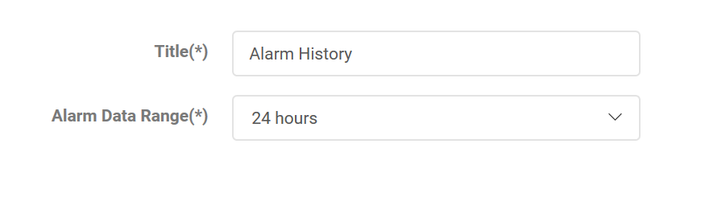
Alarm History

Slide 8
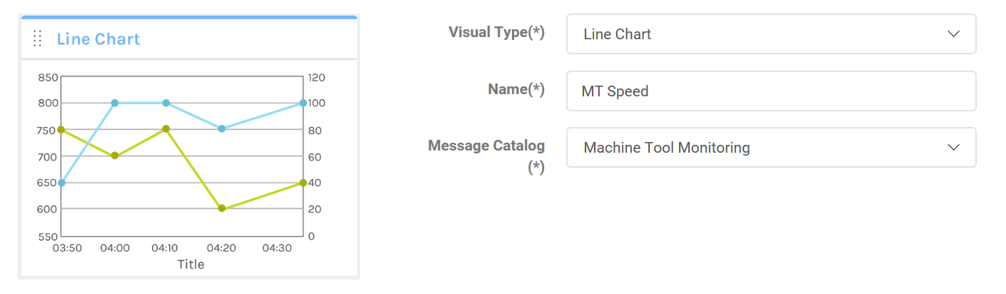
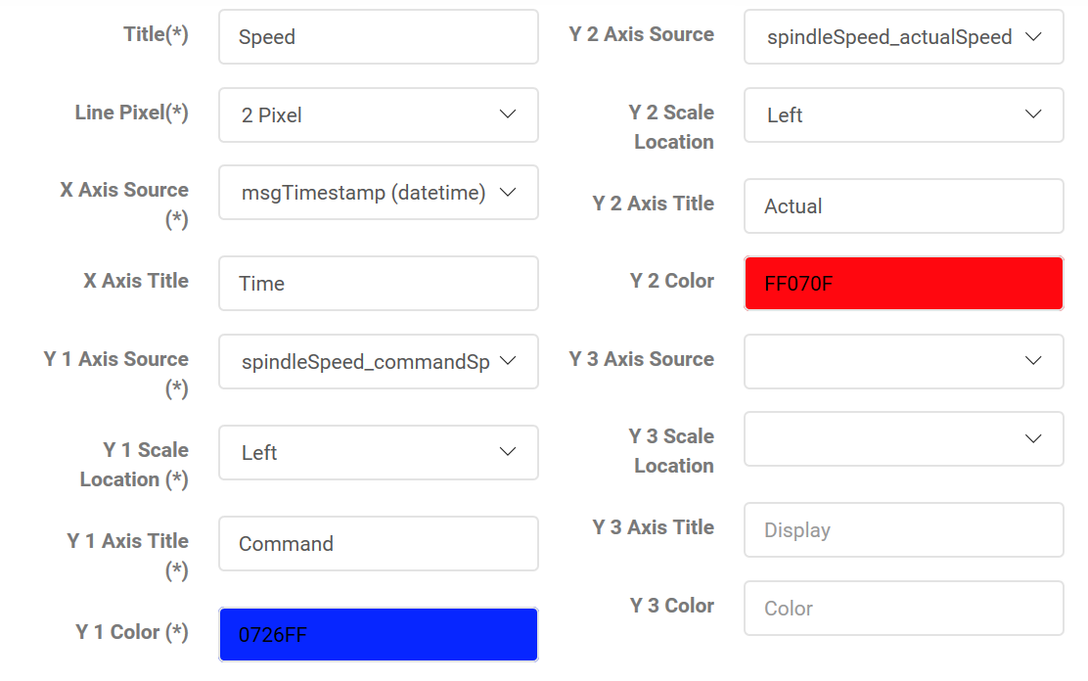
Line Chart
+ Max points on X Axis: 20
+ Max and Min value on Y Axis

Slide 9
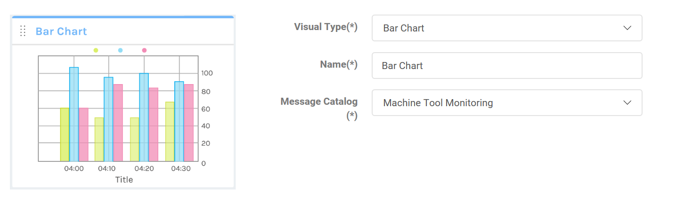
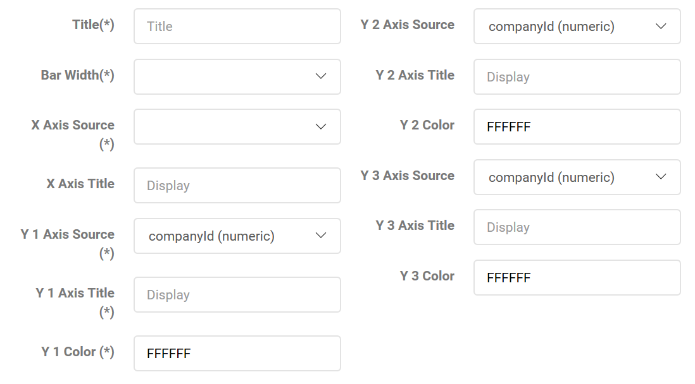
Bar Chart
+ Max points on X Axis: 20
+ Max and Min value on Y Axis

Slide 10
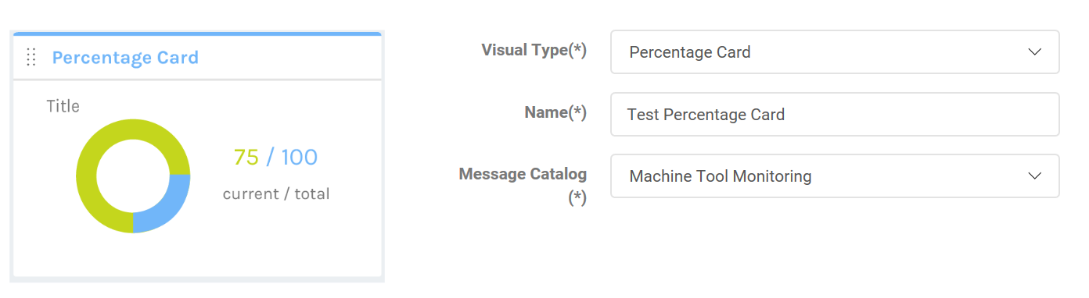
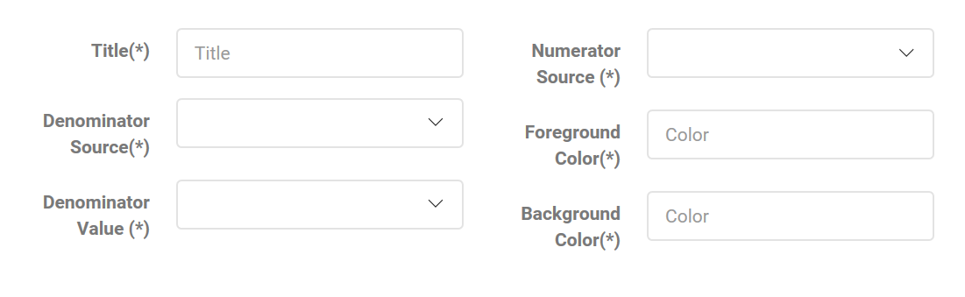
Percentage Chart
+ Enable/Disable Math.Round on Result

Slide 11
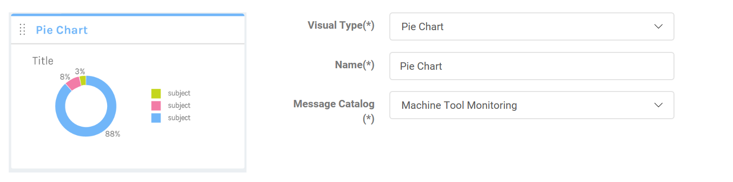
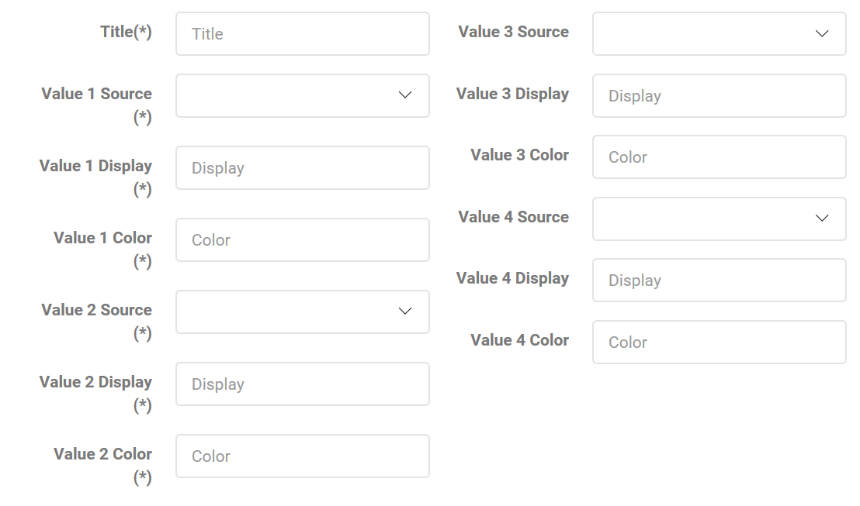
Pie Chart
+ Enable/Disable Math.Round on Result

Slide 12
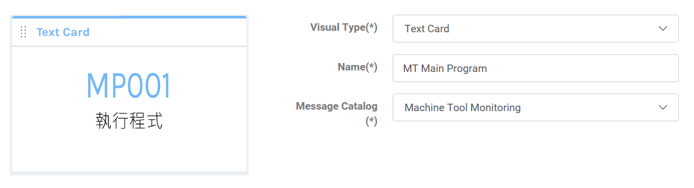
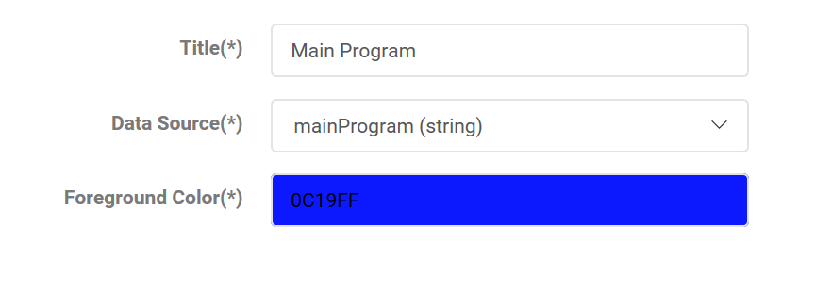
One Text
+ bgcolor

Slide 13
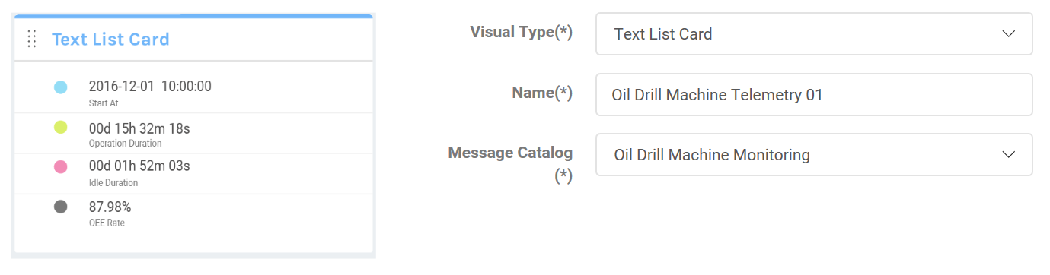
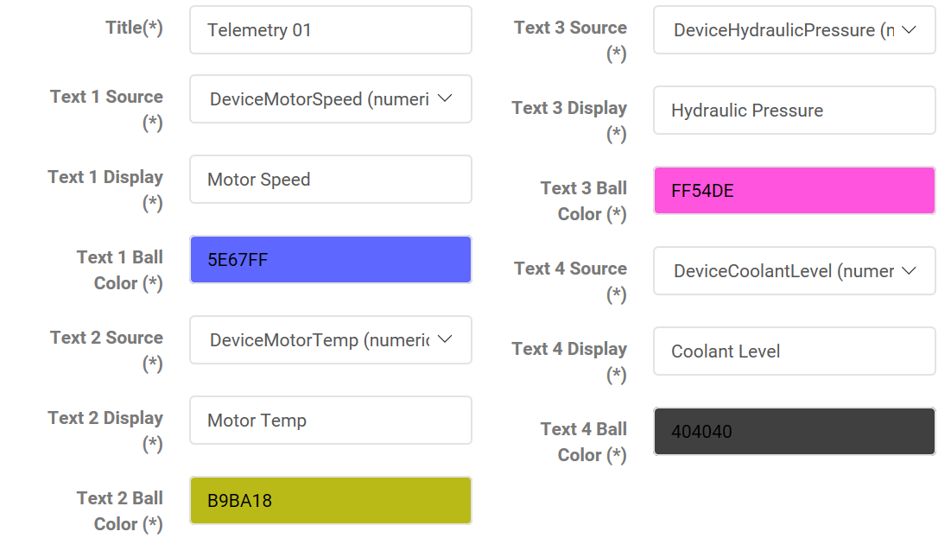
Text List
+ Enable/Disable Math.Round on each fields
Remove (*) from 2 to 4

Slide 14
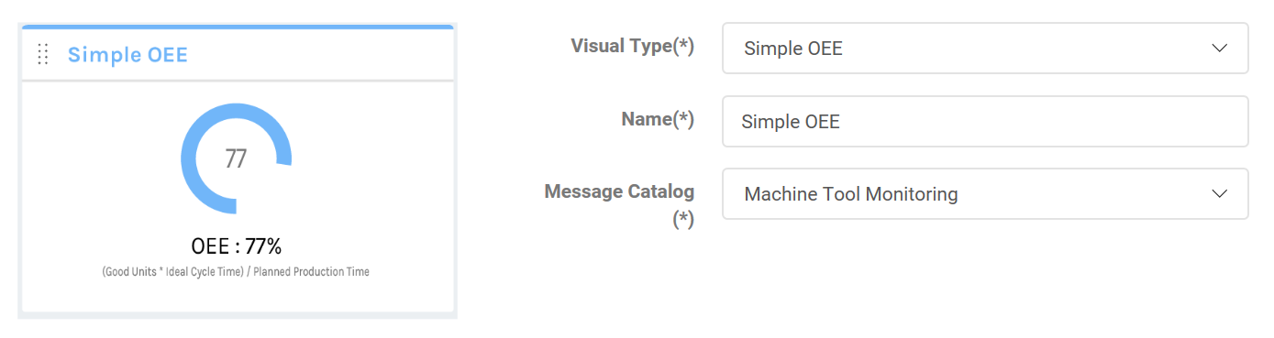
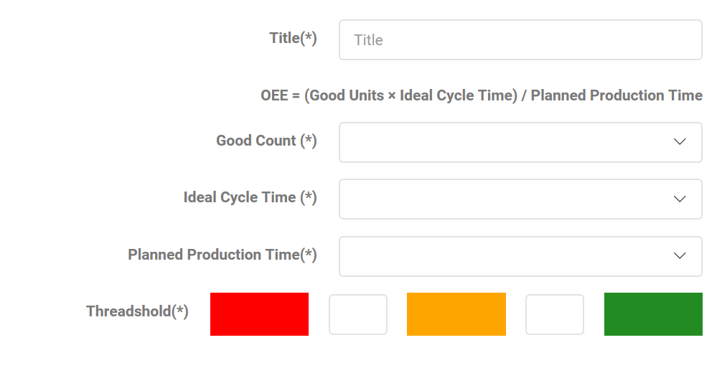
Simple OEE

Slide 15
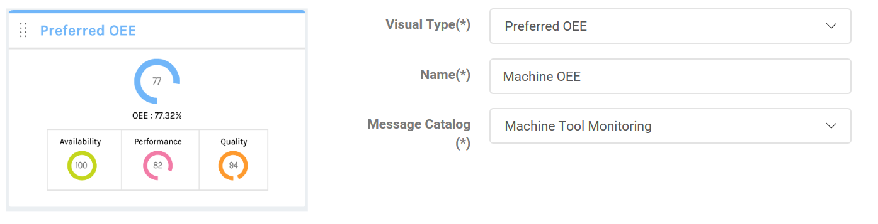
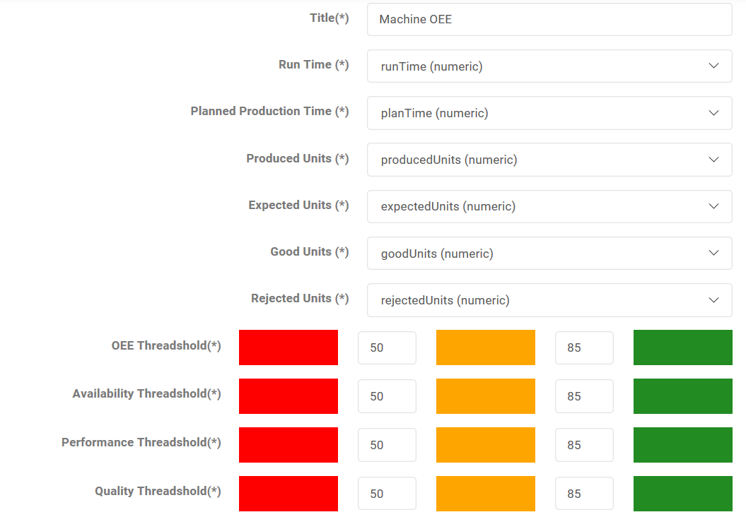
Preferred OEE

Slide 16
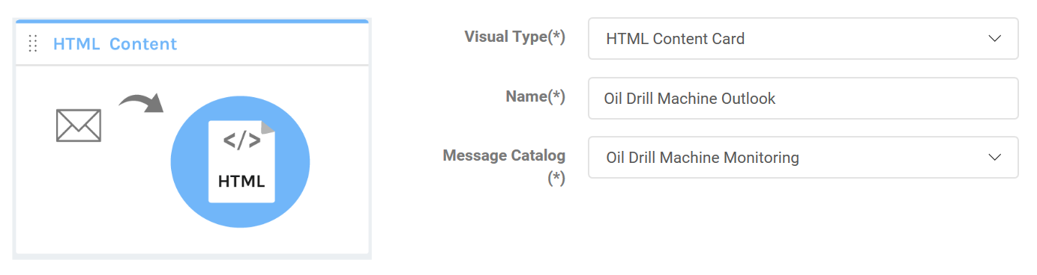
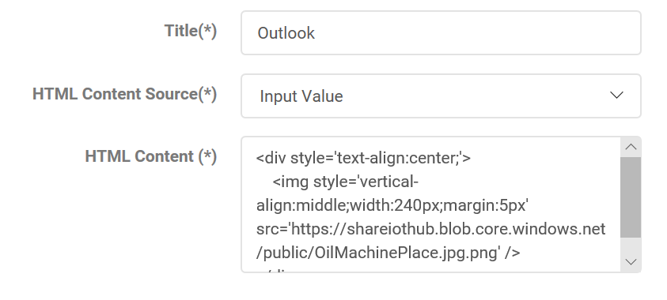
HTML Content
+ Preview Button

Slide 17
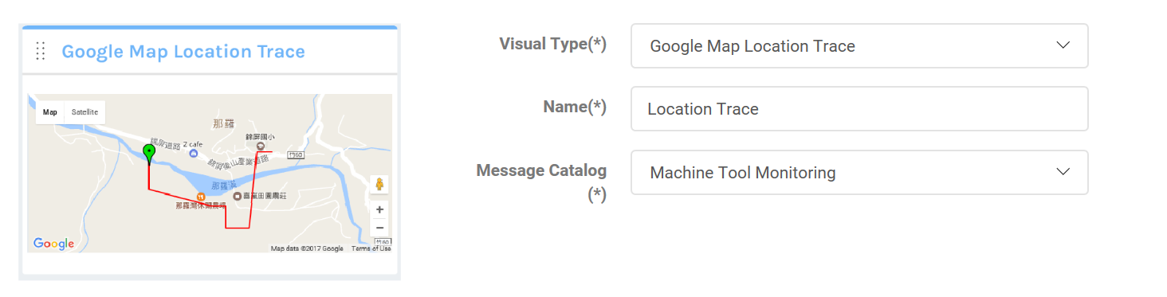
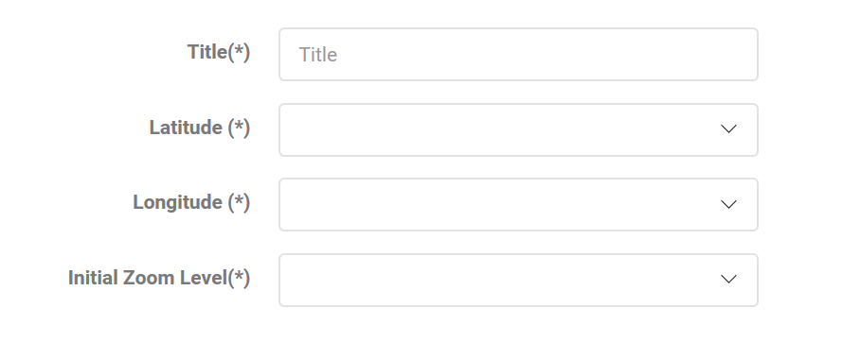
Location Trace

Slide 18
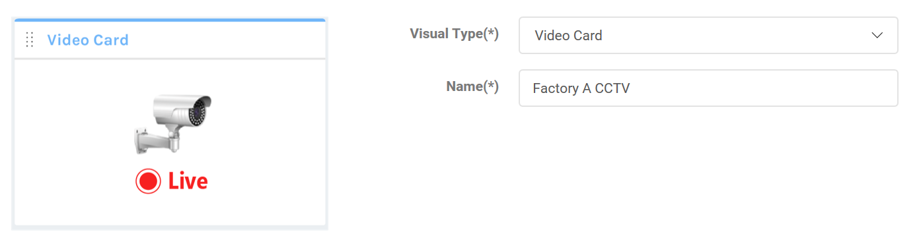
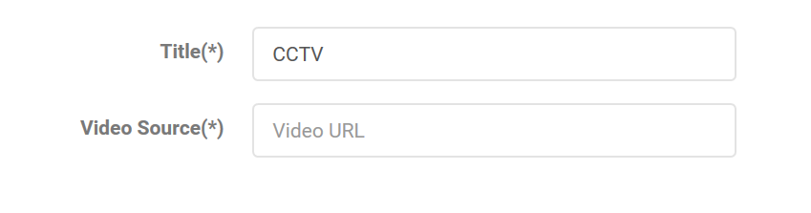
CCTV

Slide 19
Equipment Widget
No | Widget
1 | Equipment Status
2 | Equipment Location
3 | Equipment Coverage
4 | Equipment Monitoring
5 | Equipment Action
6 | Equipment Event Monitoring
7
8
9
10
11
12

Slide 20
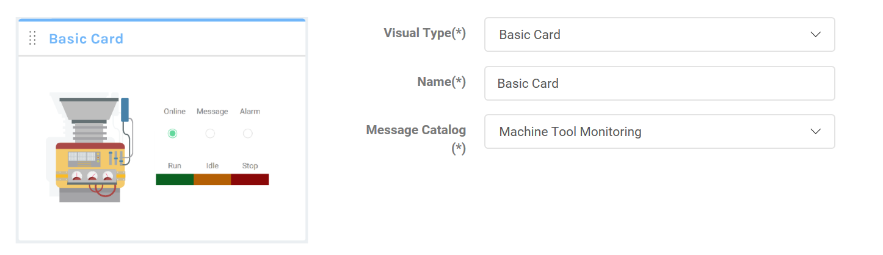
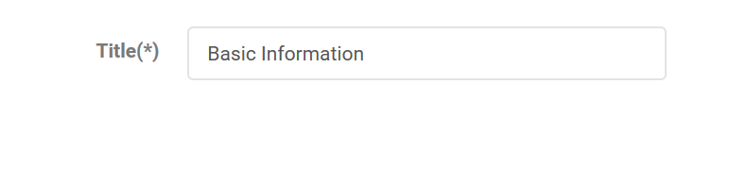
Equipment Status
Rename to Status Card
+ Run/Idle/Stop : equipmentRunStatus

Slide 21
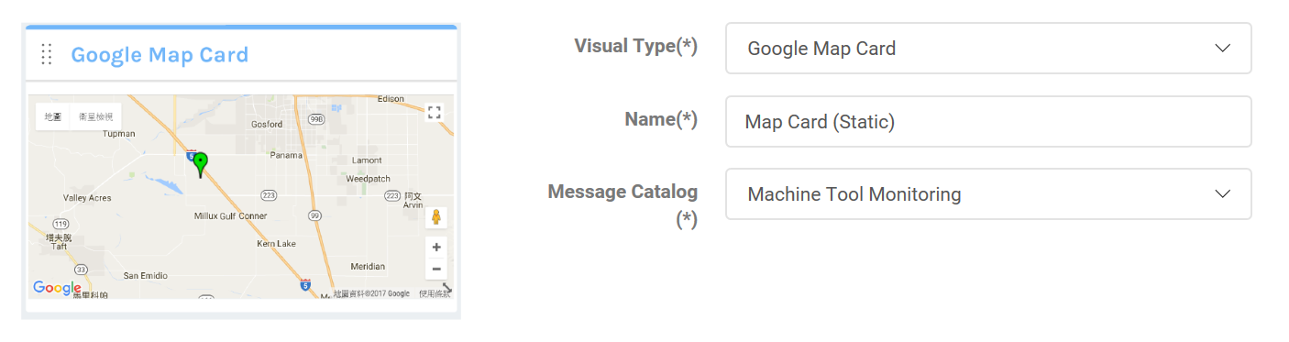
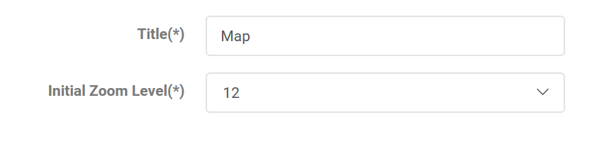
Equipment Location

Slide 22
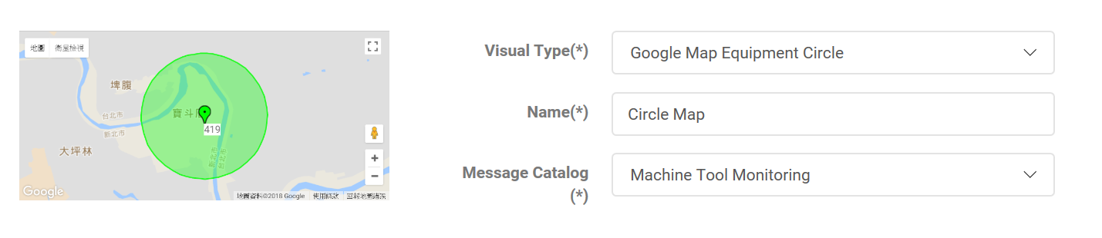
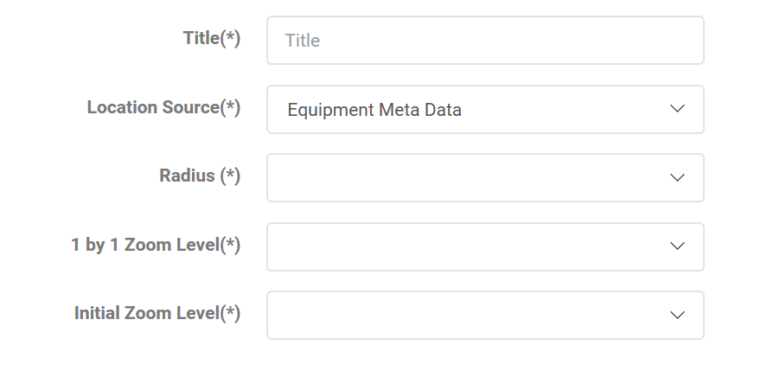
Equipment Coverage
+ Enable/Disable Math.Round on Radius

Slide 23
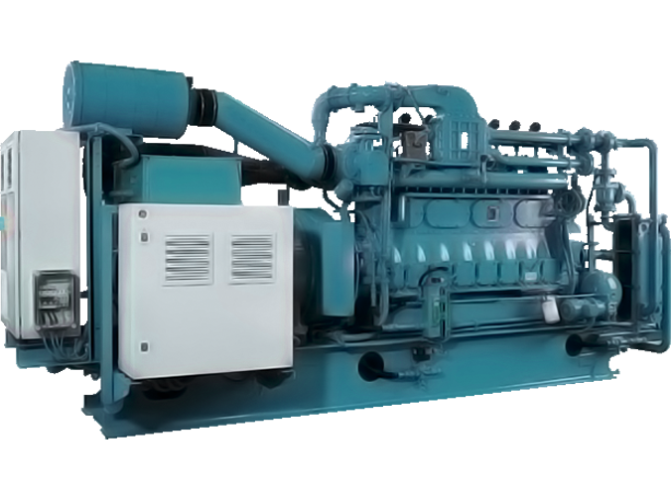
Equipment Monitoring
Click to add Node
Capture location: left and top auto, relatively
Select Node Color
Input Display Name
Select Message Element
Enable Math.Round
Select bgColor, fgColor
Delete Node, Update Node
Max Node: 20
Temperature (C)
28.05
Pressure (LB)
105
Equipment image

Slide 24

Equipment Action
Required Dashboard Write Permission
Command
List available C2D Message or Direct Method
Parameter | Value
A
B
C
List and input each value for all parameter
Submit Message to Service Bus

Slide 25
Equipment Event Monitoring
No | Event | Actions
1
2
Machine Alarm
Show Alarm on Dashboard
Email
SMS
Over Speed
Show Alarm on Dashboard
ERP: Notify

Slide 26
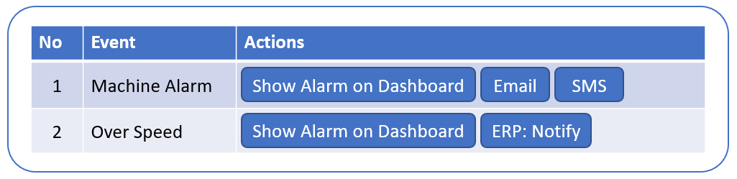
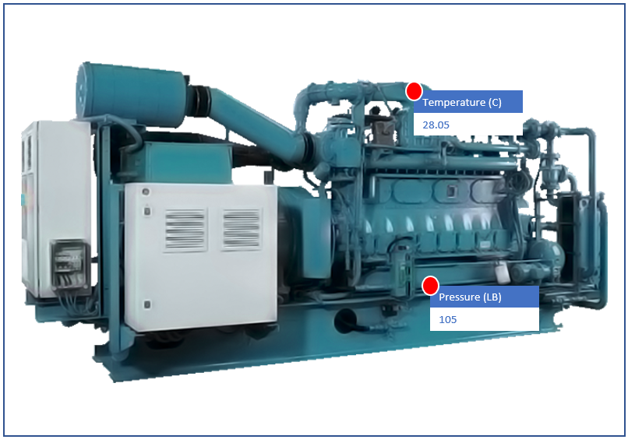
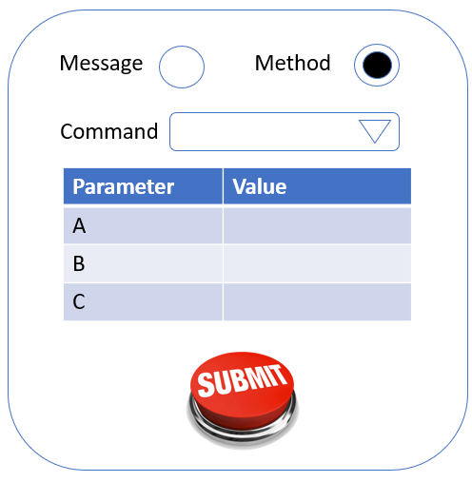
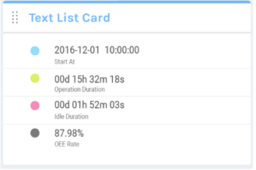
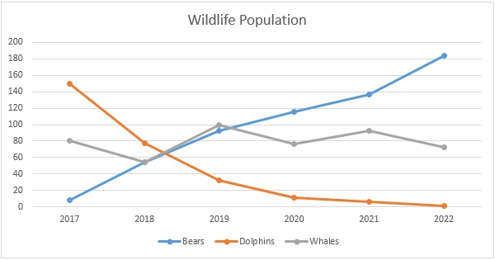
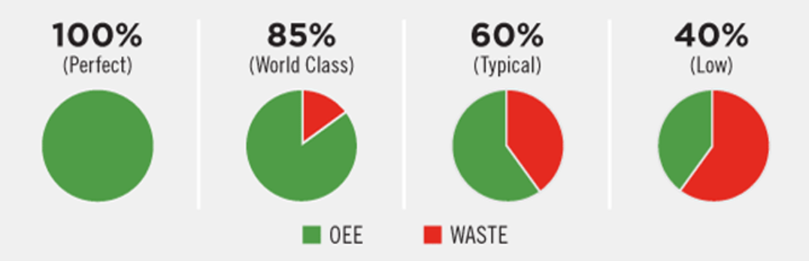
Equipment Dashboard Sample

Slide 27
Factory Widget
No | Widget
1 | Factory Location
2 | Factory Image
3 | Equipment Sum
4 | Equipment List
5 | Equipment List Coverage
6 | Production Line
7
8
9
10
11
12

Slide 28
Factory Location
+ Initial Zoom Level

Slide 29
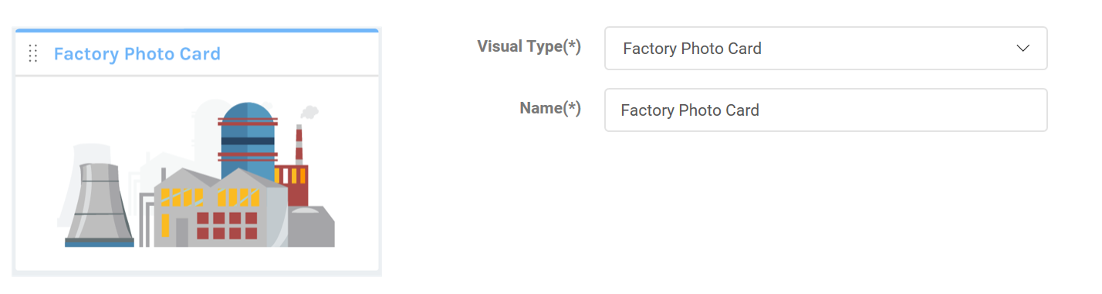
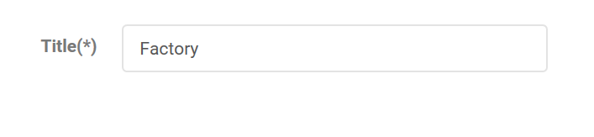
Factory Image

Slide 30
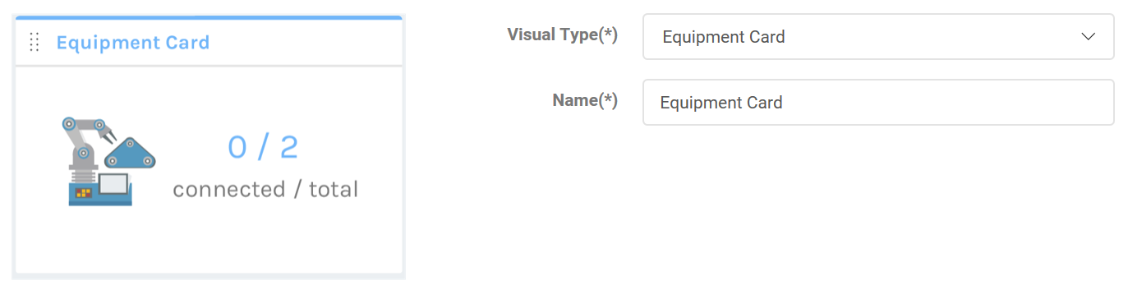

Equipment Sum

Slide 31
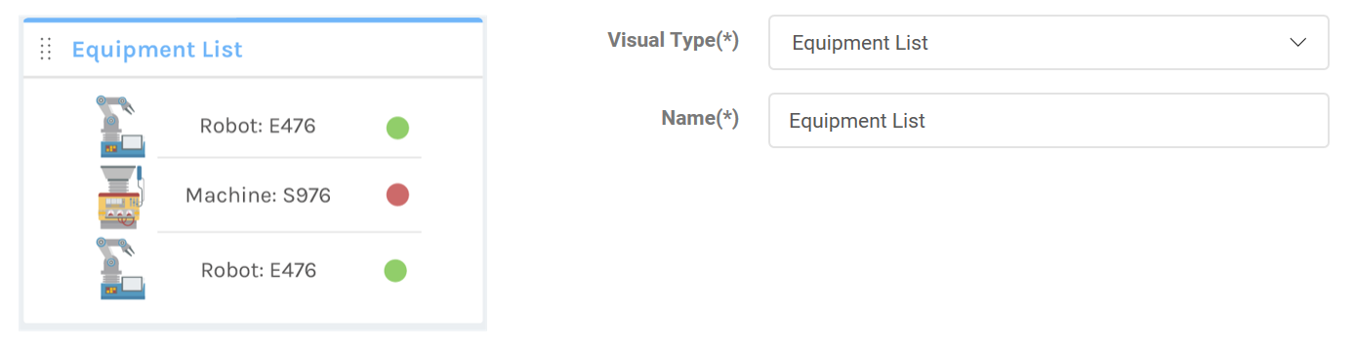
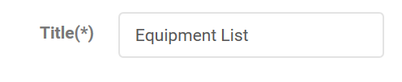
Equipment List

Slide 32


Equipment List Coverage
+ Enable/Disable Math.Round on Radius

Slide 33

Production Line Widget Designer
Factory
Stage #
8
Name
Equipment
Equipment
Equipment
Equipment
Equipment
Equipment
Equipment
Equipment

Slide 34





Production Line Widget Running
Name
XXXXX
Last Update
XXXXX
Click: go for Equipment Dashboard

Slide 35
Company Widget
No | Widget
1 | Factory Sum
2 | Factories List
3
4
5
6
7
8
9
10
11
12

Slide 36


Factory Sum

Slide 37


Factories List

